Slide 1
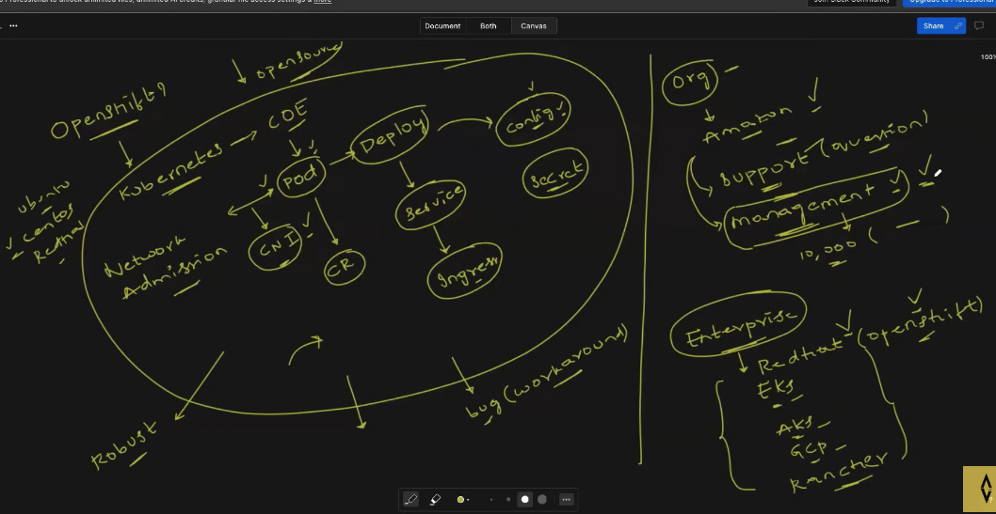
OpenShift Overview:
OpenShift is an enterprise-level Kubernetes platform developed by Red Hat. It enhances the capabilities of Kubernetes by providing additional features and support tailored for large organizations, addressing common challenges faced when deploying and managing containerized applications.
Kubernetes Recap:
Container Orchestration: Kubernetes orchestrates containers, allowing users to deploy applications in isolated environments called pods.
Deployment and Services: Pods are managed using resources like Deployments and ReplicaSets, with Service resources enabling communication and service discovery.
Ingress and Networking: Ingress resources manage incoming traffic, while Container Network Interface (CNI) handles pod-to-pod communication.
Configuration Management: ConfigMaps and Secrets are used to manage application configurations, with Secrets providing secure storage for sensitive data.
Security and Management: Kubernetes includes features like Network Policies, admission controls, and Pod Disruption Budgets to enhance security and ensure reliability.
Challenges with Open Source Kubernetes:
Lack of Support: Users may encounter issues without immediate access to expert support, leading to delays in problem resolution.
Management Overhead: The flexibility of Kubernetes can result in significant management challenges, especially when scaling applications across multiple clusters and environments.

Slide 2
Why OpenShift?
OpenShift addresses these challenges by:
Offering enterprise-grade support and services.
Reducing management complexity with streamlined installation and operation processes.
Providing additional features such as a developer-friendly interface, enhanced security, and integrated CI/CD pipelines.
Other Enterprise Kubernetes Solutions:
OpenShift is part of a broader ecosystem of enterprise Kubernetes offerings, including Amazon EKS, Azure AKS, Google GKE, and Rancher. These solutions typically build upon the open-source Kubernetes foundation, adding proprietary features to better meet enterprise needs.
In summary, OpenShift is designed for organizations seeking a robust, supported Kubernetes solution that simplifies deployment and management while enhancing security and scalability.

